Slide 1






Enhanced environmental protection inspection for efficient control of air quality monitoring and of all entities under obligation within system of greenhouse gas emission allowance trading, in order to achieve better quality of air in Republic of Croatia
This project is funded by the European Union

Slide 2



THEME 2: Pollutants

Slide 3
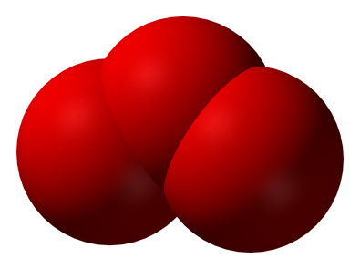

2.1 O₃ – CHEMICAL CHARACTERISTICS
European Union IPA 2013 Programme for Croatia
Ground level ozone is the most important photochemical oxidizer in the troposphere. O₃ is the secondary pollutant because it is not emitted directly from sources, but creates by photochemical reactions (the radiation of the Sun) from the nitrogen dioxide (NO₂) and easily volatile organic compounds (VOC) in the troposphere.

Slide 4
2.2 O₃ – CHEMISTRY OF PRODUCTION AND DEGRADATION
European Union IPA 2013 Programme for Croatia
Urban troposphere abounds in these compounds, and with favorable conditions comes to the formation of photochemical smog. The first condition is the creation of hydroxyl radicals (OH), which is formed by the reaction of free radicals and O* and water molecule (O* excited form of atomic oxygen):
O₃ + Sunlight  O₂ + O*
O* + H₂O  2OH

Slide 5
2.2 O₃ – CHEMISTRY OF PRODUCTION AND DEGRADATION
European Union IPA 2013 Programme for Croatia
Hydroxyl radical is the most important oxidising agent in the troposphere and it can react with all of the organic compounds in the air. The products of these reactions are molecules of water (H₂O) and an organic radical:
RH + OH  H₂O + R*
where is R (CH₃ ili CHO ili CH₂CH₃), and R* is an organic radical
R* + O₂ + M  RO₂* + M (very quick response)

Slide 6
2.2 O₃ – CHEMISTRY OF PRODUCTION AND DEGRADATION
European Union IPA 2013 Programme for Croatia
RO₂ * allows oxidation NO in NO₂ without degradation of a molecule of ozone (O₃), as shown in the reaction:
RO₂* + NO  NO₂ + RO*
In the photochemical reactions in the troposphere by oxidation, NO_{X} products are created, such as HNO₃, HNO₂, HO₂NO₂, peroxiacetil nitrate, N₂O₅, nitrate radicals and organic nitrates, and all together represent the biological irritants.

Slide 7
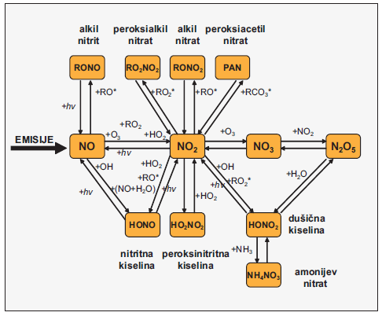
2.2 O₃ – CHEMISTRY OF PRODUCTION AND DEGRADATION
European Union IPA 2013 Programme for Croatia
Summary of interconversion ways of the oxidation of nitrogen in creation of photochemical smog.

Slide 8
2.2 O₃ – CHEMISTRY OF PRODUCTION AND DEGRADATION
European Union IPA 2013 Programme for Croatia
Summary the creation of photochemical smog
Photochemical smog is a mixture of primary and secondary pollutants in the troposphere.
2. Photochemical smog is created by a series reactions in which it transforms
nitrogen (N) in the different compounds in the atmosphere.
3. Cars emit NO and small amounts of NO₂.
Nitric oxide (NO) is actually the starting compound that is oxidized to atmospheric nitrogen dioxide (NO₂), and he is further oxidized to nitric trioxide (NO₃), which is transformed into nitric pentoxide (N₂O₅). Each of these nitrogen oxides then reacts in the photochemical processes with other atmospheric compounds, creating numerous biological irritants.

Slide 9
2.2 O₃ – CHEMISTRY OF PRODUCTION AND DEGRADATION
European Union IPA 2013 Programme for Croatia
In the reactions of the creation of photochemical smog is coming to the concentrating of ground-level ozone (O₃) in the lower layers of the troposphere.
6. The resulting mixture of photochemical smog consists of more than 100 chemical compounds.

Slide 10
2.3 O₃ – SPATIAL AND TEMPORAL DISTRIBUTION
European Union IPA 2013 Programme for Croatia
The ambient ozone concentrations depend on several factors: the intensity of insolation, the height of the atmospheric layer of temperature inversion, concentrations of nitrogen oxide and volatile organic compounds and their ratios. The most favourable ratio for the creation of ozone is:
VOC: NO_{X} = 4:1 or 10:1

Slide 11
2.3 O₃ – SPATIAL AND TEMPORAL DISTRIBUTION
European Union IPA 2013 Programme for Croatia
Ozone shows significant spatial variations that depend on the:
prevailing wind directions
tendency of achieving a higher concentration in the suburbs and rural areas,
higher elevations
In the vicinity of the big source of emission of nitric oxides concentrations of ozone are less because with them get in a chemical reaction. This results in higher concentrations of ozone in the suburbs and the rural areas of such as those along the major roads.

Slide 12
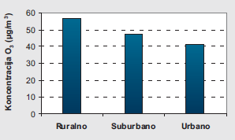
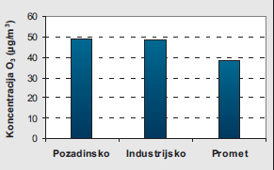
2.3 O₃ – SPATIAL AND TEMPORAL DISTRIBUTION
European Union IPA 2013 Programme for Croatia
Annual mean values of ozone measured in Europe have shown the highest value on the background stations (49 μg/m³) and stations which are located in rural areas (57.1 µg/m³). The values measured in urban areas and along major roads are lower by about 24%.
Rural Suburban Urban
Background Industrial Traffic
The average annual values of concentration of O₃ is categorized according to the location of the measurement. Source: AIRNET.
The average annual values of concentration of O₃ is categorized according to a source of pollution. Source: AIRNET.

Slide 13
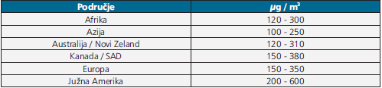
2.3 O₃ – SPATIAL AND TEMPORAL DISTRIBUTION
European Union IPA 2013 Programme for Croatia
The values of maximum ozone hourly concentration measured in urban environments of different continents range between 100 to 380 µg/m³, except in South America where they are much more (200 to 600 μg/m³)
Area
Africa
Asia
Australia/New Zeland
Canada/USA
Europe
South America

Slide 14
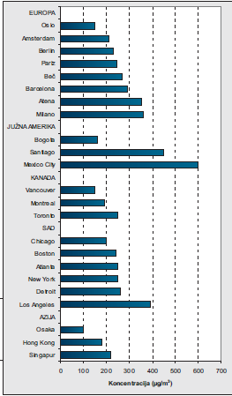
2.3 O₃ – SPATIAL AND TEMPORAL DISTRIBUTION
European Union IPA 2013 Programme for Croatia
The values of the measurements of the highest average ozone hourly concentration in the big cities of Europe are increasing to the South, and so in Oslo amounts 150 μg/m³, in Vienna 280 μg/m³, while in Athens and Milan is around 350 μg/m³. Santiago and Mexico City are noted for very high values (450 μg/m³ and 600 μg/m³), while in the United States by the amount of ozone concentration extracts only Los Angeles 390 μg/m³

Slide 15
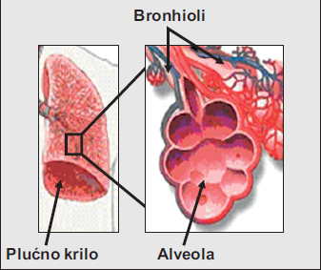
2.4 O₃ – TOXICOLOGICAL AND PUBLIC HEALTH ASPECTS of
European Union IPA 2013 Programme for Croatia
Ozone enters into the body inhaling and since it is poorly soluble in water, inhaled is transported deep into the lungs where it damages the bronchioles entering the alveoli.
Bronchioles
Lung

Slide 16
2.4 O₃ – TOXICOLOGICAL AND PUBLIC HEALTH ASPECTS
European Union IPA 2013 Programme for Croatia
The short term ozone inhalation causes diffuse inflammation of the entire respiratory system, just as some parts of (nasal and the walls of the alveoli) more sensitive, so it is an inflammation of the stronger expressed.
Ozone on its way into the deeper airways damages the cells of the respiratory tract, causing inflammation of the lungs and reduce respiratory function. Inflammation is detected almost immediately after exposure on the basis of the occurrence of inflammatory mediators in the bronchi, and inflammatory cells usually appear after several hours.
There are indications that acute inflammation induced by ozone is not limited to the respiratory system because they are the markers of systemic inflammation such as complement activation and increased protein synthesis and found in the liver.

Slide 17
2.4 O₃ – TOXICOLOGICAL AND PUBLIC HEALTH ASPECTS
European Union IPA 2013 Programme for Croatia
Depending on the concentration of ozone, repeating or long-term exposures and individual sensitivity, comes to the irreversible changes in the respiratory tract, including the damage to the DNA molecule.
This cell damage are a consequence of oxidative stress that cause secondary oxidation products.
Inflammation of the lung tissue, fluid accumulation and mobilization of macrophages in three weeks after exposure to lead to duplication of lung epithelial cells, proliferation of fibrous tissues and thickening of the pulmonary alveoli.

Slide 18
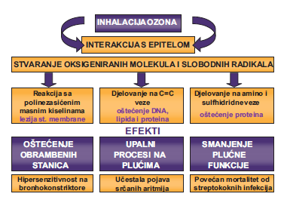
2.4 O₃ – TOXICOLOGICAL AND PUBLIC HEALTH ASPECTS
European Union IPA 2013 Programme for Croatia
OZONE INHALATION
INTERACTION WITH EPITEL
PRODUCTION OF OXIGENATED MOLECULES AND FREE RADICALS
Reaction with polyunsaturated fatty acids
cell membrane lesion
Acting on C=C bonds
DNA, lipides and proteins damage
Acting on amino and sulphydride bonds
Proteins damage
EFFECTS
immune cell damage
lung inflammation
reduction of pulmonary function
bronchoconstrictor hypersensitivity
cardiac arrhythmias
increased mortality from streptococcal infections
Systemic effects of ozone oxidative stress mechanism

Slide 19
2.4 O₃ – TOXICOLOGICAL AND PUBLIC HEALTH ASPECTS
European Union IPA 2013 Programme for Croatia
Ozone is associated with a greater number of serious effects on health that may be associated with acute and chronic exposure.
Acute exposure to ozone causes adverse systemic effects on the lung tissue and cardiovascular system.
Chronic exposure causes a reduction in lung function, the development of atherosclerosis, asthma, and shortening of the expected duration of life.

Slide 20
2.4 O₃ – TOXICOLOGICAL AND PUBLIC HEALTH ASPECTS
European Union IPA 2013 Programme for Croatia
According to the recommendations of the World Health Organization (WHO) is set border concentration of ambient ozone, which refers to the 8-hour daily maximum in which in the majority of persons should not occur the appearance of the disease.
It is possible that at an extremely sensitive person and below those concentrations show up negative health effects. As the ozone concentration greater than the limit values, these are the health effects of all the more serious and more frequent and affect a larger part of the population.

Slide 21
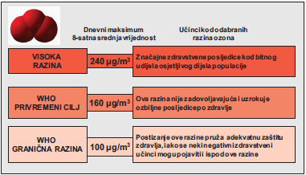
2.4 O₃ – TOXICOLOGICAL AND PUBLIC HEALTH ASPECTS
European Union IPA 2013 Programme for Croatia
daily maximum 8-hour mean value
effects of selected ozone levels
high level
Significant health effects in sensitive populations
WHO
temporary goal
Significant health effects
WHO
border level
Adequate health protection
The risk of adverse health effects in a healthy population at selected 8-hour daily maximum ozone concentrations. Source: Air Quality Guidelines-The WHO.

Slide 22
2.4 O₃ – TOXICOLOGICAL AND PUBLIC HEALTH ASPECTS
European Union IPA 2013 Programme for Croatia
Recommended values (μg/m³), the concentration of O₃ in the air-the WHO
Pollutant
Time of averaging
Temporary goal
Recommended value

Slide 23
2.5 O₃ – MEASUREMENT METHODS
European Union IPA 2013 Programme for Croatia
The reference method for the measurement of ozone
Ultraviolet (UV) photometry (HRN EN 14625)
Prescribed by regulations of the Republic of Croatia and the European Union. In the European Union and Croatia, was adopted by 2012. year

Slide 24
2.5 O₃ – MEASUREMENT METHODS
European Union IPA 2013 Programme for Croatia
The method is based on a property of ozone that absorbs the UV-radiation.
Sampled air at the entrance of the instrument are filtered out by a constant and known flow, leads to a reaction of the cell in which the conditions are constant pressure and temperature. In such conditions the air exposes the constant radiation exposure low pressure lamps with peak values of 253.7 nm.

Slide 25
2.5 O₃ – MEASUREMENT METHODS
European Union IPA 2013 Programme for Croatia
Sensitive photodiode or photomultiplier detectors measure the intensity of the radiation that is passed through the reaction cell. Ozone in the air absorbs a certain amount of radiation that is in constant terms proportional to the concentration of ozone in the sample.
There are two basic ways of quantifying and absorption:
one is to get through the same reaction cell passes alternating pattern of air and air without ozone
another is that there are two identical cells and through one continuous passes air sample, and through other air without ozone

Slide 26
2.5 O₃ – MEASUREMENT METHODS
European Union IPA 2013 Programme for Croatia
In both modes the air without ozone is obtained by conducting air through the catalytic convector for ozone. The difference in intensity of radiation that is measured in the air with ozone and no ozone represents the absorption of radiation.
Sampling of air containing a known concentration of ozone instrument is calibrated and is possible with the help of absorption from the calibration directions to calculate the concentration of ozone.

Slide 27
2.5 O₃ – MEASUREMENT METHODS
European Union IPA 2013 Programme for Croatia
If the instrument is calibrated in volume/volume units, concentrations of O₃ are measured directly in volume/volume units (ppb) whereas the absorption in the UV spectrum is proportional to the concentration of O₃ in the volume/volume units.
After that, the obtained concentrations in ppb are converted to μg/m³ using standard conversion factors for a temperature of 20°C and an atmospheric pressure of 1013 hPa.
1 ppb (nmol/mol) O₃ = 2.00 μg/m³ O₃

Slide 28
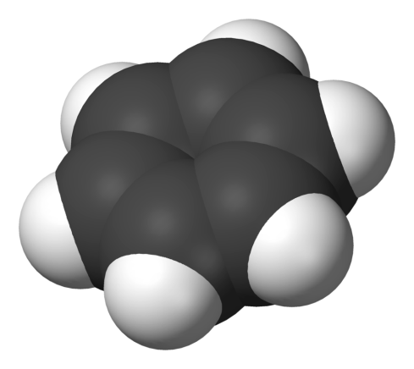
2.1 C₆H₆ – CHEMICAL CHARACTERISTICS
European Union IPA 2013 Programme for Croatia
Benzene (C₆H₆) is a colourless liquid, easily volatil at room temperature. In the air is located mostly in the gas stage, with a time of retention varies between a few hours to a few days. The retention time in the air depends on the environment, the climate and the concentration of other pollutants. From the air is removed by rain, and decomposes in the reaction with hydroxyl radicals.

Slide 29

2.1 C₆H₆ – CHEMICAL CHARACTERISTICS
European Union IPA 2013 Programme for Croatia
Benzene is a cyclic hydrocarbon with alternation single and double bonds in the ring
Different ways of displaying the chemical formula of benzene

Slide 30
2.1 C₆H₆ – CHEMICAL CHARACTERISTICS
European Union IPA 2013 Programme for Croatia
By using X-ray, it was found that all of the C-C bond in benzene are the same length (140 pm). However, this is greater than the length of the double C = C bond (135 pm), but smaller than the single C-C bond (147 pm). This indicates the relocation of electrons, which means that all of the electrons in these connections arranged equally between all six carbons by making a resonance structure. Such delocalization of electrons is known as aromatic and gives benzene in particular a strong stability, which is a fundamental property of aromatic molecules that sets them apart from the non-aromatic constituents.

Slide 31
2.3 C₆H₆ – SPATIAL AND TEMPORAL DISTRIBUTION
European Union IPA 2013 Programme for Croatia
Natural and anthropogenic sources
Benzene is a natural component of crude oil and gasoline with a share of 1 to 5 volume percentage. In EU countries, 5% is the maximum allowed proportion of benzene in oil and gasoline.
Up to 1990. year total benzene emissions from cars engines was 60%, but today, the use of catalysts and fuel with a lower proportion of benzene total emissions decreased at 20%.

Slide 32
2.3 C₆H₆ – SPATIAL AND TEMPORAL DISTRIBUTION
European Union IPA 2013 Programme for Croatia
Benzene is emitted into the air and evaporation in the handling, transport and storage of gas chemical industry also represents an essential source of benzene.
Various processes fossil fuel combustion (coal with the already mentioned oil and petrol), and we find it and in the smoke of cigarettes. Natural sources of benzene are deposits of oil and natural gas.

Slide 33
2.3 C₆H₆ – SPATIAL AND TEMPORAL DISTRIBUTION
European Union IPA 2013 Programme for Croatia
Concentration in the air
Average daily ambient concentrations of benzene in rural areas amount to about 1 μg/m³ in urban areas range from 5 to 20 μg/m³. In the vicinity of sources of emissions of benzene concentrations are more important.
Average daily concentration measured in the major cities (Montreal, Toronto, Houston, New York, Pittsburg, Oslo, London) vary in the range of 2.8 to 40 μg/m³.

Slide 34
2.3 C₆H₆ – SPATIAL AND TEMPORAL DISTRIBUTION
European Union IPA 2013 Programme for Croatia
At gas stations at the time of refueling the concentration of benzene in the air are very high and amount to 3.2 mg/m³.
In the homes of smokers amounts 11 μg/m³, while they are in the homes of non-smokers is lower (6.5 μg/m³).
In the interior of the vehicle while driving the concentration of benzene showed values in the range from 10 to 120 μg/m³ in Germany, 37 to 57 µg/m³ in Sweden, 30 to 115 μg/m³ in the Netherlands and 12 to 50 μg/m³ in the United States.

Slide 35
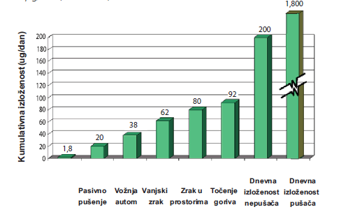
2.4 C₆H₆ – TOXICOLOGICAL AND PUBLIC HEALTH ISSUES
European Union IPA 2013 Programme for Croatia
Inhaling in the organism enters more than 99% of benzene, as they entered a minimum of food and water. The average daily exposure to benzene at non-smokers is about 200 μg/day, while in smokers who smoke 30 cigarettes a day, nine times higher and amounts to about 1800 μg/day.
Daily exposure to benzene non-smokers and smokers who smoke 30 cigarettes a day. Source: Wallace, 1996.; Egeghy, et al., 2000.
Daily exposure nonsmokers
Daily exposure smokers
Passive smokers
Car driving
Outdoor
Indoor
Reffueling

Slide 36
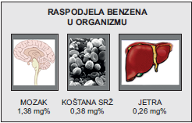
2.4 C₆H₆ – TOXICOLOGICAL AND PUBLIC HEALTH ISSUES
European Union IPA 2013 Programme for Croatia
Entered into the body, benzene is, since there is soluble in fats, accumulates in the tissues with a large lipid content, and they are: brains, bone marrow and liver.
Levels in workers who died from exposure to high concentrations amounted to 1.38 mg% in the brain, 0.38 mg% in bone marrow and 0.26 mg% in the liver
(units mg% = mg of some substances in 100 g of tissue in which that substance has accumulated).
brain
bone marrow
liver

Slide 37
2.4 C₆H₆ – TOXICOLOGICAL AND PUBLIC HEALTH ISSUES
European Union IPA 2013 Programme for Croatia
In autopsy findings of young addicts who have died because of the deliberate inhalation solution that contained benzene, the value and distribution of benzene in the tissues was the following: 2 mg% in the blood, 3.9 mg% in the brain, 1.6 mg% in the liver, 1.9 mg% in the kidneys and 2.2 mg% in the belly fat the tissue.
Oxidative metabolism of benzene in the body occurs in the liver through a system of cytochrome P-450 2E1. The average time to half-lives of benzene in the organism is 28 hours.

Slide 38
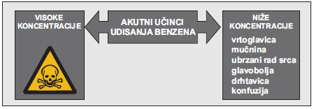
2.4 C₆H₆ – TOXICOLOGICAL AND PUBLIC HEALTH ISSUES
European Union IPA 2013 Programme for Croatia
Acute toxicity of benzene is low. Acute effects of benzene inhalation poisoning depend on inhaled concentrations. After inhaling a very high concentration is death, and the inhalation of lower concentrations may affect poisoning symptoms such as dizziness, nausea, rapid heartbeat, tremors, confusion.
HIGH CONCENTRATIONS
ACUTE EFFECTS OF INHALED BENZENE
LOWER CONCENTRATIONS
dizziness
nausea
rapid heartbeat tremor confusion

Slide 39
2.4 C₆H₆ – TOXICOLOGICAL AND PUBLIC HEALTH ISSUES
European Union IPA 2013 Programme for Croatia
Long-term exposure to increased concentrations of benzene causes harmful effects to your health: haematotoxicity, genotoxicity carcinogenicity.
Haematotoxicity manifested in reduced production of blood cells, red blood cells and platelets in the bone marrow. In patients who have been professionally exposed to benzene concentrations of 120 mg/m³ was found a reduction in the number of erythrocytes and leukocytes in the blood.

Slide 40
2.4 C₆H₆ – TOXICOLOGICAL AND PUBLIC HEALTH ISSUES
European Union IPA 2013 Programme for Croatia
Genotoxicity of benzene is manifested induction of mutations of genes, structural and numeric chromosomal aberation. Carcinogenicity is reflected in the appearance of leukemia and lymphoma and other malignancies.
Benzene is carcinogen, so there is no safe level of the exposure that can be recommended.

Slide 41
2.4 C₆H₆ – TOXICOLOGICAL AND PUBLIC HEALTH ISSUES
European Union IPA 2013 Programme for Croatia
Because of the carcinogenic properties of benzene, the World Health Organization gives recommended values for benzene, have already calculated the risks of contracting the disease of leukemia during the whole lifetime exposure to benzene.
lifetime exposure to concentration (μg/m³)
Risk of leukemia

Slide 42
2.5 C₆H₆ – MEASUREMENT METHODS
European Union IPA 2013 Programme for Croatia
The reference method for the measurement of benzene includes
Sampling suctioning with thermal desorption and analysis of gas chromatography (norm EN 14662-1)
Prescribed by regulations of the Republic of Croatia and the European Union. In the European Union is adopted in 2005. years, and in Croatia in 2006.

Slide 43
2.5 C₆H₆ – MEASUREMENT METHODS
European Union IPA 2013 Programme for Croatia
The method is based on the classic gas chromatography and detection with the help of fire (FID) or photoionizing(PID) detectors. It is also allowed to use any other suitable detector.
Measure the air volume by pumping into the pre-column with an adsorbent that binds the benzene from the sample, and the air without benzene exits the instrument.
After that, benzene vapor is released from the adsorbent and by inert gas (most often high nitrogen purity) transferred to a chromatographic column where benzene separates from other easily volatile hydrocarbons (xylene, toluene).

Slide 44
2.5 C₆H₆ – MEASUREMENT METHODS
European Union IPA 2013 Programme for Croatia
Benzene will be carried by the inert gas after passing through a column in exactly the specified time called retention time (for the same chemical compound, the same system and the same conditions, the retention time is always the same) to enter the detector that will register the passage of benzene signal proportionate mass of benzene.
By comparing the signal with the signal of a zero air (air without benzene) and the signal obtained by passing the air with known concentration of benzene obtained during the procedure of calibration of the instrument can calculate the concentration of benzene in the sample sample.

Slide 45
2.5 C₆H₆ – MEASUREMENT METHODS
European Union IPA 2013 Programme for Croatia
After that, the concentration is calculate in μg/m³ using standard conversion factors for a temperature of 20°C and an atmospheric pressure of 1013 hPa.

Slide 46
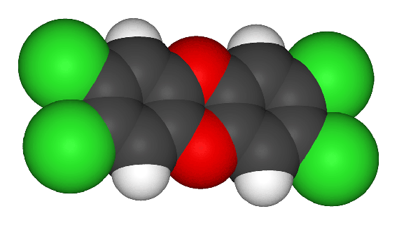
2.1 DIOXINS — CHEMICAL CHARACTERISTICS
European Union IPA 2013 Programme for Croatia
Dioxins are a group of highly toxic organic chemical compounds. Once they get into the environment (air, soil, water), due to its stability remain a long time in it and is implanted into the food chains with the ability biomagnification (increase of the concentration of in the direction of the upper levels of the food chain). In the body they accumulate in adipose tissue where their half-life is 7 to 11 years.

Slide 47
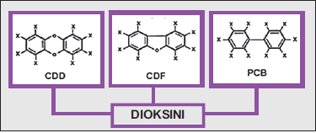
2.1 DIOXINS — CHEMICAL CHARACTERISTICS
European Union IPA 2013 Programme for Croatia
The term dioxins is a general term that refers to chemical compounds that have similar chemical structure and biological characteristics. There are several hundred of such compounds that can be included in three very close subgroups: chlorinated dibenzo-p-dioxins (CDDs), chlorinated dibenzofurans (CDFs) and policlorinated biphenyls (PCBs).
DIOXINS
Note: X in formulas can be atom of chlorine (Cl) or hydrogen (H) depending on the type of chemical compounds

Slide 48

2.1 DIOXINS — CHEMICAL CHARACTERISTICS
European Union IPA 2013 Programme for Croatia
It consists of two benzene rings that are attached to the CDDs by two oxygen atoms in CDF with one oxygen atom and to PCBs directly without oxygen atoms. The chlorine atoms (Cl) are attached to the benzene rings.
The most toxic dioxin is 2, 3, 7, 8-tetrachlorodibenzo-p-dioxin

Slide 49
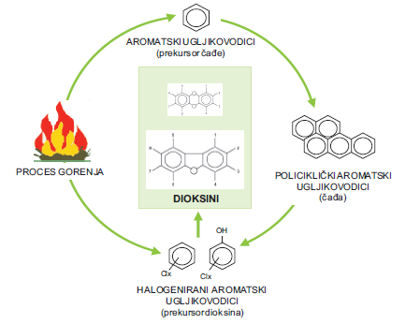
2.2 DIOXINS – CHEMISTRY OF PRODUCTION AND DEGRADATION
European Union IPA 2013 Programme for Croatia
One of the ways of formation of dioxin are processes of incomplete combustion (e.g. burning of plastics-polyvinyl chloride-PVC) in which it comes to the creation of aromatic hydrocarbons that are fused together in a polycyclic aromatic hydrocarbons, then halogenate, and halogenated aromatic hydrocarbons become precursors for the formation of dioxin.

Slide 50
2.3 DIOXINS – SPATIAL AND TEMPORAL DISTRIBUTION
European Union IPA 2013 Programme for Croatia
Anthropogenic sources
Dioxins and furans are mostly unwanted products formed in industrial processes, power stations, paper factories, herbicides and pesticides, the burning of waste, etc., while PCB products are used as insulators in transformers and other electrical devices. One part of the dioxin pollutes the environment unsuitable long-term storing of industrial oils and oil containing PCBs.

Slide 51
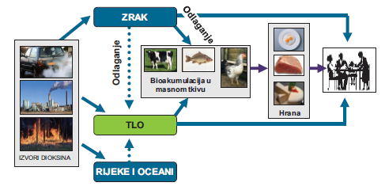
2.3 DIOXINS – SPATIAL AND TEMPORAL DISTRIBUTION
European Union IPA 2013 Programme for Croatia
Natural sources
Natural sources of dioxins are mostly volcanic eruptions and forest fires. Although dioxins are created locally, the distribution in the environment is a global, because they are found in all media throughout the world. High levels of dioxin were found in soil, sediment, and feed, particularly in meat, fish and shellfish.
AIR
deposition
deposition
bioaccumulation
food
SOIL
RIVERS AND OCEANS

Slide 52
2.3 DIOXINS – SPATIAL AND TEMPORAL DISTRIBUTION
European Union IPA 2013 Programme for Croatia
The concentration of dioxin in the air vary with the seasons. In the summer is much lower than in the winter and amounts to 0.1- 0.5 pg-TEQ (toxicity equivalent)/m³.
Winter ambient concentrations range from 6 to 8 pg-TEQ/m³.
TEQ is equivalent toxicity that was introduced because the received dose of dioxin in the body not only consists of one compound, but mostly of more of them, each of which has its own TEF (toxicity equivalence factor) which is determined by the most toxic dioxin 2, 3, 7.8- TCDD and that has a TEF = 1.

Slide 53
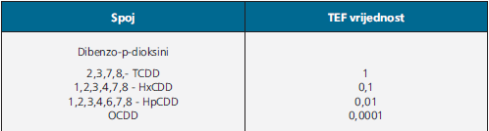
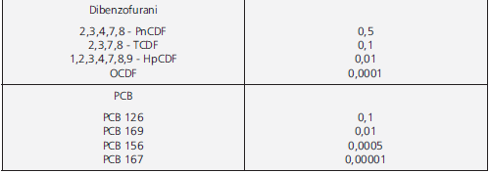
2.3 DIOXINS – SPATIAL AND TEMPORAL DISTRIBUTION
European Union IPA 2013 Programme for Croatia
TEF values for each individual compound that belongs to the dioxins. Source: WHO.
Compound
TEF

Slide 54
2.4 DIOXINS – TOXICOLOGICAL AND PUBLIC HEALT ASPECTS
European Union IPA 2013 Programme for Croatia
95% of dioxins in the organism entered by contaminated food, and a small percentage by the air. When dioxins gets into the organism, tied in to the cellular Ah dioxin receptor. At the time of binding comes to the activation of this receptor and the launch of two fixed event:
the first is the increase in the transcription of the entire series of genes that encode the synthesis of enzymes such as cytochrome P4501A1, 1A2, 1B1, glutathione S-transferase and UDP-glucurono-siltransferase
the second is the activation of the enzyme tyrosine kinase. These events result in endocrine changes and changes in the growth and differentiation of cells
That's exactly the basis of toxicity of dioxin.

Slide 55
2.4 DIOXINS – TOXICOLOGICAL AND PUBLIC HEALT ASPECTS
European Union IPA 2013 Programme for Croatia
Toxicokinetics determinants of dioxin are dependent on its three basic properties:
lipophilicity
metabolism
ability of binding to a CYP1A2 protein in the liver
Since the dioxin slowly metabolized, comes to the bioaccumulation, and the induction of CYP1A2 proteins there is an increase in the concentration of dioxin in the liver, and the reduction in the concentration of dioxin in other organs and tissues.

Slide 56
2.4 DIOXINS – TOXICOLOGICAL AND PUBLIC HEALT ASPECTS
European Union IPA 2013 Programme for Croatia
The average daily dose of dioxin, which enters the organism is 1.5 to 2 pg per kg of body weight/day.
It is necessary to point out that the amount of dioxin in the organism enters by food, not through the air. Whereas the levels of dioxin in the air is low, inhaling enters in the organism 0.03 pg/kg body weight/day.
According to the WHO limit of daily intake tolerance is 10 pg/kg of body weight.

Slide 57
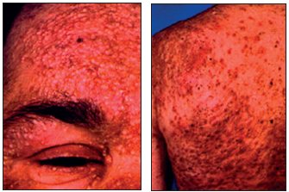
2.4 DIOXINS – TOXICOLOGICAL AND PUBLIC HEALT ASPECTS
European Union IPA 2013 Programme for Croatia
Exposure to dioxins at high doses, it can cause a number of adverse health effects. Health effects associated with the entering of dioxin in the body are dependent on several factors including:
the level
the length of the exposure
frequency location
The most common health effects in people who were exposed to high doses of dioxin (accidents) are the chlorine acne that appear mainly on the face and upper body. Long-term exposure to elevated concentrations of dioxins increases the risk of all types of malignant diseases.

Slide 58
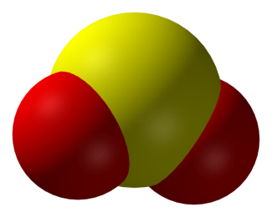
2.1 CHEMICAL CHARACTERISTICS OF H₂S
European Union IPA 2013 Programme for Croatia
Hydrogen sulphide H₂S is a colorless, toxic and flammable gas with a characteristic smell of rotten eggs. It is soluble in water and alcohol.

Slide 59
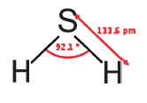
2.1 CHEMICAL CHARACTERISTICS OF H₂S
European Union IPA 2013 Programme for Croatia
It is consists of two molecules of hydrogen covalently linked to one molecule of sulfur.

Slide 60
2.2 H₂S – CHEMISTRY OF PRODUCTION AND DEGRADATION
European Union IPA 2013 Programme for Croatia
Occurs in anaerobic conditions (without the presence of oxygen) at bacterially degradability of sulfates in organic substance, and in industrial processes where sulphur compounds come into contact with organic substances at elevated temperatures.

Slide 61
2.3 H₂S – SPATIAL AND TEMPORAL DISTRIBUTION
European Union IPA 2013 Programme for Croatia
Natural sources
It is most commonly found in:
the surroundings of geothermal wells
wetlands
mixture of gases by volcanic eruptions.
It is an integral part of the crude oil and natural gas, and in some dumps of natural gas the concentrations are up to 42%.
Since it is heavier than air, transports along the Earth's surface.

Slide 62
2.3 H₂S – SPATIAL AND TEMPORAL DISTRIBUTION
European Union IPA 2013 Programme for Croatia
The most common anthropogenic sources are:
paper industry
wastewater treatment
refining of crude oil
production of coke
The usual concentration of hydrogen sulfide in the air is below 0.3 μg/m³, except in areas where it is naturally released into the air. So for example in the vicinity of the town of Rotorua in New Zealand (extremely active geothermal area) measured concentrations are more than 80 μg/m³ in more than 55% of the days in the winter months. In Croatia are elevated concentrations of this gas (more than 50 μg/m³) measured near an oil refinery in Sisak and Rijeka.

Slide 63
2.4 H₂S – TOXICOLOGICAL AND PUBLIC HEALTH ASPECTS
European Union IPA 2013 Programme for Croatia
At physiological pH (pH 7.4) hydrogen sulphide dissociate as the sulphide anion and is absorbed through the lungs, is spreading quickly in the body, and metabolised in three ways:
oxidation
metilation
reaction with cytochrom c and metalo-proteins or disulphide proteins
The main metabolic pathway is rapid oxidation in liver to sulfate (final product). Sulphate metabolites are excreted by feces and urine as urinary thiosulfates. Since thiosulfates in the urine are held up to 15 hours after acute exposure, they are used as a biomarker for acute exposure to hydrogen sulphide.

Slide 64
2.4 H₂S – TOXICOLOGICAL AND PUBLIC HEALTH ASPECTS
European Union IPA 2013 Programme for Croatia
The toxicity of hydrogen sulfide at concentrations of what we find in the outside air is negligible.
Acute toxicity of hydrogen sulphide is mainly reflected on the central nervous and the respiratory system. When H₂S enters the body, it creates a complex with iron from the enzyme cytochrome oxidase and in the mitochondria is blocking the binding of oxygen which stops the cellular respiration.

Slide 65
2.4 H₂S – TOXICOLOGICAL AND PUBLIC HEALTH ASPECTS
European Union IPA 2013 Programme for Croatia
The human sense of smell is extremely sensitive to this chemical compound and hydrogen sulphide can smell but also at concentrations of 10 to 12 μg/m³. Harmfulness to health hydrogen sulfide at these concentrations, it does not exist.
The World Health Organization (WHO) has given 15 mg/m³ (15 000 μg/m³) as the lowest concentration that causes negative effects on health (LOAEL). The usual method of divide these values with the safety factor (in this case, he's tall -100). WHO issued a recommended value of 24-hour concentrations of hydrogen sulphide of the 150 μg/m³.

Slide 66
2.4 H₂S – TOXICOLOGICAL AND PUBLIC HEALTH ASPECTS
European Union IPA 2013 Programme for Croatia
So, only after concentrations of specified pollutants grow for a thousand times of concentration where can smell it, you can expect an acute negative effects on people's health.
However, as with its unpleasant smell, such compounds can considerably reduce the quality of life in the area which are spread, the WHO recommends that the 30-minutes hydrogen sulphide concentrations should not exceed 7 μg/m³.

Slide 67
2.4 H₂S – TOXICOLOGICAL AND PUBLIC HEALTH ASPECTS
European Union IPA 2013 Programme for Croatia
At concentrations higher than 15 mg/m³ comes to the irritation of the conjunctiva.
At higher concentrations (225 mg/m³) comes to paralysis of the olfactory nerve and the smell can no longer feel it.
At higher concentration (> 400 mg/m³) first comes to the pulmonary edema, and then to the strong stimulation of CNS (central nervous system) with symptoms such as rapid breathing, interruption of breathing, convulsion and death.

Slide 68
2.4 H₂S – TOXICOLOGICAL AND PUBLIC HEALTH ASPECTS
European Union IPA 2013 Programme for Croatia
If people are exposed to extremely high concentrations of 1400 mg/m³ and higher, is coming to a rapid development of brain edema and necrosis of brain tissue.

Slide 69
2.5 H₂S – MEASUREMENT METHODS
European Union IPA 2013 Programme for Croatia
For hydrogen sulphide there is no special standard method of measurement, but is measured at the same measuring principle as well as SO₂:
ultraviolet light (UV) fluorescence
This method could be applied, but it is necessary before the measurements from the sample of air to remove all the SO₂.

Slide 70
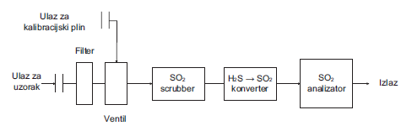
2.5 H₂S – MEASUREMENT METHODS
European Union IPA 2013 Programme for Croatia
This is achieved with the help of the so-called SOX scrubber which is located at the entrance of a sample of the air in the instrument. It's about powder adsorbent with high affinity binding of the sulfur oxides. The adsorbent is placed in the casing of scrubber which is heated to increase the speed of adsorption. Since these adsorbents have a specific capacity, must be changed regularly, which is included in the regular maintenance of the device. After the removal of SO₂, a sample of air heat is processed in the so-called converter where the oxidation of total H₂S-s in SO₂ happend. Further measurement is identical to the one described in the methods for sulphur dioxide. At the end of the obtained concentrations of SO₂ are converted and expressed as H₂S.

Slide 71
2.5 H₂S – MEASUREMENT METHODS
European Union IPA 2013 Programme for Croatia
The method is based on fluorescent radiation molecules if the SO₂ molecule is exposed to ultraviolet light (UV) radiation. Due to exposure to UV-radiation, molecules passes in the spectrophotometer from SO₂ normal to excited condition and after that again returns to normal with the airing of the fluorescent radiation.
SO₂ + hv SO₂* [1.]
SO₂* SO₂ + hv [2.]
where is SO₂* excited molecule condition.

Slide 72
2.5 H₂S – MEASUREMENT METHODS
European Union IPA 2013 Programme for Croatia
The intensity of the emitted radiation is proportional to the concentration of the SO₂ molecule in the air. Relationship between the concentration of the SO₂ molecule and the intensity of the radiation describes the following equation:
F = k x C_{so2} [3.]
where:
F = intensity of radiation; k = coefficient of proportionality; C_{SO2} = concentration of SO₂.

Slide 73
2.5 H₂S – MEASUREMENT METHODS
European Union IPA 2013 Programme for Croatia
Before entering in the reaction fluorescent chamber, the air is filtered and passed through a scrubber of hydrocarbons that would otherwise cause interference. In a reaction fluorescent chamber the sample in air is in standardized conditions exposed to UV radiation in the wavelength range of 200 to 220 nm what causes excitation of SO₂ molecules in the sample. Upon return from the excited to the normal state of the SO₂ molecule, they are fluoresced by emitting rays of wavelengths between 240 and 420 nm. This emission passes through selective optical filters and then translates it with the help of photodiode into an electric signal whose intensity is measured. The intensity of the electrical signal is proportional to the concentration of SO₂ which has entered the reaction [1.].

Slide 74

2.5 H₂S – MEASUREMENT METHODS
European Union IPA 2013 Programme for Croatia
Concentrations of SO₂ are measured directly in volume/volume units (ppb) whereas the absorption in the UV spectrum is proportional to the concentration of SO₂ in the volume/volume units. After obtaining the concentration at ppb units, the result is converted to μg/m₃ using standard conversion factors for a temperature of 20°C and an atmospheric pressure of 1013 hPa.
1 ppb (nmol/mol) H₂S = 1.12 μg/m³ of H₂S
Institut za energetiku i zaštitu okoliša

Slide 75
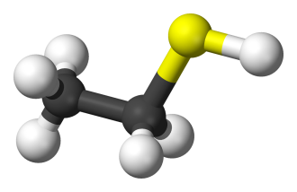
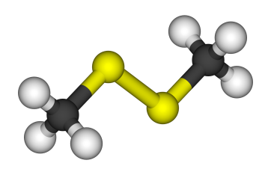
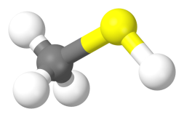
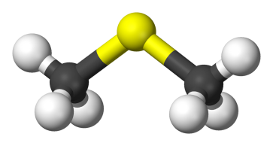
A COMPLETE AND TOTAL REDUCED SULPHUR COMPOUNDS/MERCAPTANS
European Union IPA 2013 Programme for Croatia
Total reduced sulphur is a mixture of several compounds containing reduced sulfur compounds. Apart from H₂S in that group include mercaptans, dimethyl sulfide and dimethyl disulfide. This compounds characterized by a very unpleasant smell. How in our regulations to this group of compounds represent the mercaptans on this occasion will be described in more detail.
Mercaptans or thiols are a group of organic compounds with the -SH group and are known as unpleasant odors with the lowest threshold of olfactor sensitivity (below 5 μg / m³). They are naturally developed by the breakdown of organic matter but can be found in animals and plants. They are one of the causes of unpleasant failures in people with a diseased liver.

Slide 76

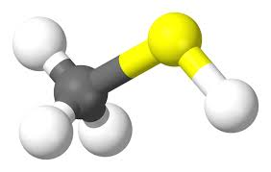
A COMPLETE AND TOTAL REDUCED SULPHUR COMPOUNDS/MERCAPTANS
European Union IPA 2013 Programme for Croatia
This group of compounds is considerably less represented in the present toxicological and medical literature. Not one from a group of these compounds is not represented in the WHO Air quality guidelines, and WHO does not give the recommended values for these compounds. Most often they are represented in the present literature in the area of the protection at work and so the maximum permissible concentration (MPC) for the 8-hour working time after toxicological research is to 1000 μg/m³ for methyl-and ethyl-mercaptane in most countries.

Slide 77

A COMPLETE AND TOTAL REDUCED SULPHUR COMPOUNDS/MERCAPTANS
European Union IPA 2013 Programme for Croatia
The US ATSDR (Agency for Toxic Substances and Registry Diesase) gives the concentration of 5000 μg/m³ at which do not appear on health effects (NOAEL). As far as the maximum acceptable concentration (due to unpleasant smells) data are available from the same agency for some States in the USA, so that New York has a border on 3.30 μg/m³ for an annual value, and Virginia 16.0 μg/m³ for 24-hour value for methyl mercaptane. And here is our stricter regulations so the GV (border value) for 24 hour 3 μg/m³.
1 ppb (nmol/mol) H₂S = 1.12 μg/m³ of H₂S

Slide 78
THANK YOU FOR YOUR ATTENTION !
Disclaimer: The contents of this publication are the sole responsibility of EKONERG – Energy Research and Environmental Protection Institute, Ltd. and can in no way be taken to reflect the views of the European Union
This project is funded by the European Union

